Slide 1
Automatic Text Summarization

Slide 2
Outline
What is Text Summarization?
Text Summarization Techniques Classification
Our Target
Related Work
Dataset
Data Exploration
Data Preprocessing
What’s Next?

Slide 3
What is Text Summarization?
Text summarization is the process of creating a short and coherent version of a longer document.

Slide 4
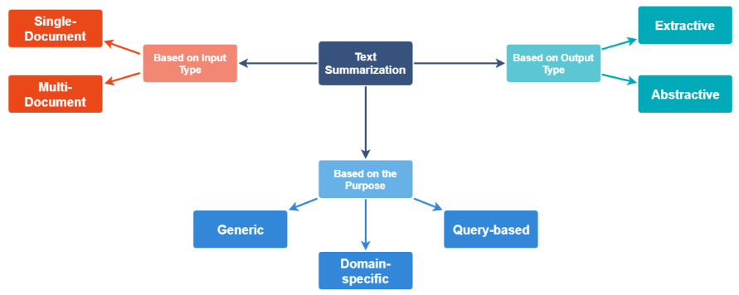
Text Summarization Techniques Classification
Text summarization methods can be classified into 3 different types:
Source

Slide 5
Text Summarization Techniques Classification
Single Document _ input length is short.
Multi Document _ input can be arbitrarily long.
Based on Input Type

Slide 6
Text Summarization Techniques Classification
Generic _ model makes no assumption about the domain of input text - most common so far.
Domain-Specific_ model uses domain-specific knowledge to form a more accurate summary.
Query-Based _ summary only contains information that answers natural language questions about input text.
Based on Purpose

Slide 7
Text Summarization Techniques Classification
Extractive _ important sentences are selected from input text to form a summary- most approaches today are extractive in nature.
Abstractive _ model forms its own phrases and sentences to offer a more coherent summary - more appealing, but much more difficult than extractive summarization.
Based on Output Type

Slide 8
Our Target
In our problem, we will follow the single-document generic abstractive approach.

Slide 9
Related Work
Now, we’ll demonstrate some of the state-of-the-art models, which have dealt well with such a topic.

Slide 10
Related Work
Published in April, 2017.
Used DMQA Dataset.
Tried to solve: Factual errors, OOV (Out-of-Vocab) words and Repeating.
Evaluated the model with ROUGE-1, ROUGE-2, ROUGE-L and METEOR.
Pointer-Generator Networks

Slide 11
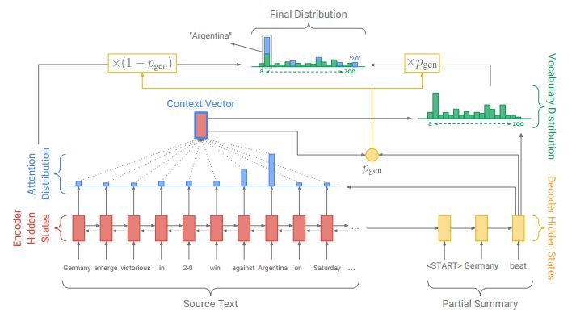
1. Pointer-generator model

Slide 12
Related Work
Published in Nov, 2017.
Used DMQA Dataset.
Following the Abstractive approach.
Tried to solve: Trivial & Generic summary, Limited grammaticality & readability and MLE Shortcomings.
Evaluated the model with ROUGE-1, ROUGE-2, ROUGE-L.
Generative Adversarial Network for Abstractive Text Summarization

Slide 13
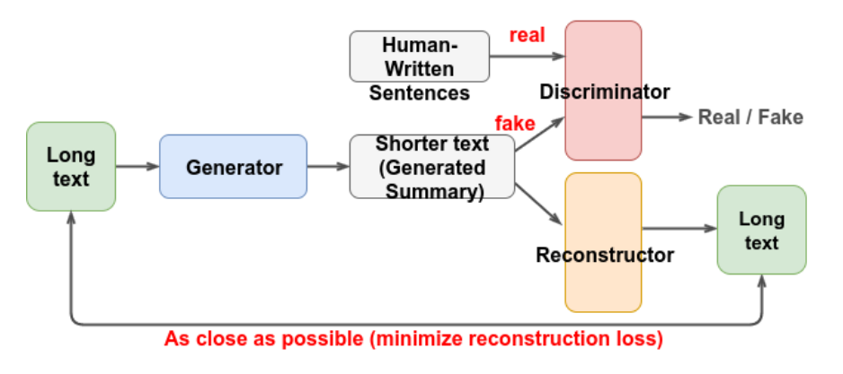
2. GAN model _ source

Slide 14
Related Work
Published in February, 2019.
Used DMQA and NYT Datasets.
Following the Abstractive approach.
Tried to solve: Left-context-only decoder and not utilizing the Pretrained contextualized language models.
Evaluated the model with ROUGE-1, ROUGE-2, ROUGE-L and ROUGE-AVG.
Pretraining-Based Natural Language Generation for Text Summarization

Slide 15
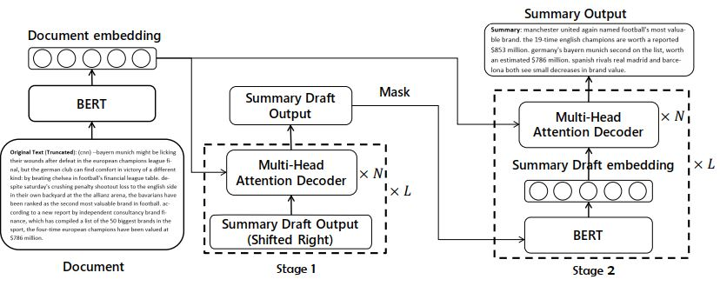
3. Pretraining-based model

Slide 16
 | ROUGE-1 | ROUGE-2 | ROUGE-L
Pretraining-based Model | 41.71 | 19.49 | 38.79
GAN Model | 39.92 | 17.65 | 36.71
Pointer-Generator Model | 39.53 | 17.28 | 36.38

Slide 17
Dataset
We will be using the CNN dataset _ part of DeepMind Q&A Dataset.
A large collection of news articles from CNN.
Contains around 93,000 news articles where each article is stored in a single “.story” file.

Slide 18
Data Exploration
Exploring the dataset, we can see the following pattern:
Each story has the story content, followed by a number of “highlight” points.
Many articles start with source information, presumably the CNN office that produced the story.
Many articles will contain numbers, punctuations, acronyms, etc.
Middle-cropped Sample
(CNN) -- If you travel by plane and arriving on time makes a difference, try to book on Hawaiian Airlines. In 2012, passengers got where they needed ... In fact, Hawaiian got even better from 2011, when it had a 92.8% on-time performance. Last year, it improved to 93.4%.
@highlight
Hawaiian Airlines again lands at No. 1 in on-time performance
@highlight
The Airline Quality Rankings Report looks at the 14 largest U.S. airlines
@highlight
ExpressJet and American Airlines had the worst on-time performance
@highlight
Virgin America had the best baggage handling; Southwest had lowest complaint rate

Slide 19
Data Preprocessing
We have tried the following on a small sample of the dataset:
We first start by splitting the story content from associated highlights, using these highlights as our ground truth summarization.
We then apply different preprocessing techniques on both story content and highlights.

Slide 20
Eliminate CNN prefix
Along with associated offices
05
Remove numeric values
Many news articles will contain numeric data as part of the story?
01
04
Tokenize
Lemmatize
Preferred over stemming
Convert to lowercase
Acronyms issue is still being under consideration
02
03
Remove punctuation and stopwords
Stopwords are modified to exclude some negated helping verbs
Data Preprocessing

Slide 21
Sample Raw Input
(CNN) -- The 54 men and 14 boys rescued after being found chained this week at an Islamic religious school in Pakistan have been reunited with their families or placed in shelters, authorities said.
The group was discovered in an underground room with heavy chains linking them together.
The school, Al-Arabiya Aloom Jamia Masjid Zikirya, which also was a drug rehab clinic, is in Sohrab Goth, a suburb of Gadap in Karachi.
All 14 boys were returned to their families, senior police official Ahsanullah Marwat told CNN.
Of the adults, 47 had been released to their families, and seven were handed over to a shelter for the homeless, he said.
Three people who worked at the facility were arrested, but the four men who ran the place were still at large, Marwat said.
Officials said the facility was part madrassa and part drug-rehab facility, and the captives were chained at night apparently to prevent their escape.
"The operation was successful, and we plan on continuing our work to ensure that places like this are shut down," Marwat said. Many of the captives told police their families sent them there because they were recovering drug addicts. During the day, they worked and did religious studies. But the future of the rescued children was unclear.
One woman told a local television station that she was willing to pay the police to keep her troublesome child.
She said she would rather have the facility remain open, regardless of how it treated the children.
Many others, however, said they were in shock and disbelief over the allegations.
One man complained he was deep in debt after paying the school a large amount of money to board his son.
@highlight
Captive boys and men were rescued from an Islamic religious school in Pakistan
@highlight
They were reunited with their families this week
@highlight
The facility was a school and drug rehab clinic
@highlight
Authorities say they're searching for the owners; three others arrested at the facility

Slide 22
Story
After Splitting: (CNN) -- The 54 men and 14 boys rescued after being found chained this week at an Islamic religious school in Pakistan have been reunited with their families or placed in shelters, authorities said. The group was discovered in an underground room with heavy chains linking them together. The school, Al-Arabiya Aloom Jamia Masjid Zikirya, which also was a drug rehab clinic, is in Sohrab Goth, a suburb of Gadap in Karachi. All 14 boys were returned to their families, senior police official Ahsanullah Marwat told CNN. Of the adults, 47 had been released to their families, and seven were handed over to a shelter for the homeless, he said. Three people who worked at the facility were arrested, but the four men who ran the place were still at large, Marwat said. Officials said the facility was part madrassa and part drug-rehab facility, and the captives were chained at night apparently to prevent their escape. "The operation was successful, and we plan on continuing our work to ensure that places like this are shut down," Marwat said. Many of the captives told police their families sent them there because they were recovering drug addicts. During the day, they worked and did religious studies. But the future of the rescued children was unclear. One woman told a local television station that she was willing to pay the police to keep her troublesome child. She said she would rather have the facility remain open, regardless of how it treated the children. Many others, however, said they were in shock and disbelief over the allegations. One man complained he was deep in debt after paying the school a large amount of money to board his son.
After Preprocessing:
[' 54 men 14 boy rescued found chained week islamic religious school pakistan reunited family placed shelter authority said ', 'group discovered underground room heavy chain linking together ', 'school alarabiya aloom jamia masjid zikirya also drug rehab clinic sohrab goth suburb gadap karachi ', '14 boy returned family senior police official ahsanullah marwat told cnn ', 'adult 47 released family seven handed shelter homeless said ', 'three people worked facility arrested four men ran place still large marwat said ', 'official said facility part madrassa part drugrehab facility captive chained night apparently prevent escape ', ' operation successful plan continuing work ensure place like shut marwat said ', 'many captive told police family sent recovering drug addict day worked religious study ', 'future rescued child unclear ', 'one woman told local television station willing pay police keep troublesome child said would rather facility remain open regardless treated child ', 'many others however said shock disbelief allegation ', 'one man complained deep debt paying school large amount money board son ']

Slide 23
Highlights
After Splitting:
['Captive boys and men were rescued from an Islamic religious school in Pakistan',
'They were reunited with their families this week',
'The facility was a school and drug rehab clinic',
"Authorities say they're searching for the owners; three others arrested at the facility"]
After Preprocessing:
['captive boy men rescued islamic religious school pakistan',
'reunited family week',
'facility school drug rehab clinic',
'authority say re searching owner three others arrested facility']

Slide 24
What’s Next?
Study different model architectures
Implement our own model
Evaluate the model using test split
Compare results

Slide 25
Gantt Chart
Investigation and Proposal
February
March
April
May
Week 1
Week 2
Week 3
Week 4
Week 1
Week 2
Week 3
Week 4
Week 1
Week 2
Week 3
Week 4
Week 1
Week 2
Week 3
Week 4
Data Preprocessing
Model Architecture
Model Implementation
Model Evaluation

